Slide 1
3413ICT Network Security
Lecture 6A: Information Systems Security Management
Dr V. Muthukkumarasamy
B.Sc.Eng (Hons) (Peradeniya), PhD (Cantab), MIEE, MIEEE

Slide 2
Previous Lecture..
We have studied;
Malicious programs
Trapdoor, logic bomb, trojan horse, zombie, viruses, worms
Countermeasures
Types of firewalls
Firewall configurations

Slide 3
Today’s Objectives
To understand network management functions
To study about security policy
To understand security incidents, backup, system continuity planning, and disaster recovery
To understand consumer privacy & computer forensics

Slide 4
References
Computer Security Principles and Practice, (2nd Edition), W. Stallings & L. Brown,
Chapter 14

Slide 5
Balancing Security and Access
It is impossible to obtain perfect security - it is not an absolute; it is a process
Security should be considered a balance between protection and availability
To achieve balance, the level of security must allow reasonable access, yet protect against threats
Notes:
Security And Access Balancing
When considering information security, it is important to realize that it is impossible to obtain perfect security. Security is not an absolute; it is a process not a goal.
Security should be considered a balance between protection and availability.
To achieve balance the level of security must allow reasonable access, yet protect against threats.

Slide 6
Network Management Functions
Configuration management:
Knowing what hardware & software are where
Performance & fault management:
Making sure the system operates as desired
Security management:
Security (policy, technology, processes) implementation, maintenance, etc.
End user support:
Assisting end users
Cost management:
Minimizing the cost of providing network services

Slide 7
Security Policy
Security policy is the foundation & structure in which you can ensure your security program
Policy is a form of document that is created to enforce procedures revolving around security
Without it, you leave the system open and vulnerable
Policy is customizable to each organization

Slide 8
Security Policy Development Life Cycle

Slide 9
Information Security Standards
AS/NZS ISO/IEC17799:2001
By Standards Australia & Standards New Zealand
A code of practice for information security management
It provides recommendations for information security management for use by those who are responsible for initiating, implementing or maintaining security in their organization

Slide 10
Information Security Standards
AS/NZS ISO/IEC17799:2001 includes
Security policy
Organizational security
Asset classification and control
Personnel security
Physical environmental security
Communications and operations management
Access control
Systems development and maintenance
Business continuity management
Compliance

Slide 11
Security Incidents
Incidents Happen
Protections sometimes break down
Incident Severity
False alarms
Minor incidents
Major incidents
Disasters

Slide 12
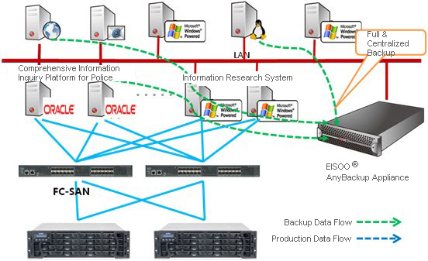
Backup & Disaster Recovery
Backup technology – centralized backup
Business continuity plan
Disaster recovery

Slide 13
Backup Technology
Administrator
PC with
Backup
Device
Directory
Server
Data
Mail
Server
File Server

Slide 14
Business Continuity Plan
A business continuity plan specifies how a company plans to restore core business operations when disasters occur
Prioritizations of business processes
The plan should be updated frequently, because of the changes of business conditions
Telephone numbers and contact numbers must be updated even more frequently than the plan as a whole

Slide 15
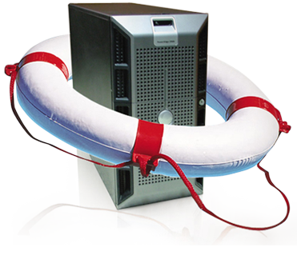
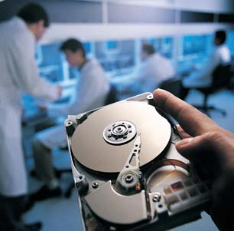
Disaster Recovery
Disaster Recovery
Disaster recovery looks specifically at the technical aspects of how a company can get back into operation, using backup facilities

Slide 16
Consumer Privacy
Scott McNealy of SUN Microsystems:
“You have zero privacy now. Get over it!”
But privacy is strong in European Union countries and some other countries
Australian government
“Privacy Act 1988”
“Privacy Amendment (Private Sector) Act 2000”

Slide 17


A True Story on Privacy
In 1989, the California Department of Motor Vehicles (DMV) was selling driver-licence data of state residents.
A famous actress Rebecca Schaeffer (1967 – 1989, best known for her role in the sitcom, My Sister Sam), was murdered
The state police later found that Robert Bardo (Born 1970) was the murderer, who bought Rebecca’s address
California state passed a law to prohibit the DMV from releasing home addresses
Rebecca Schaeffer
Robert Bardo

Slide 18
Australian 10 National Privacy Principles
Principle 1 - Collection
Principle 2 - Use and disclosure
Principle 3 - Data quality
Principle 4 - Data security
Principle 5 - Openness
Principle 6 - Access and correction
Principle 7 - Identifiers
Principle 8 - Anonymity
Principle 9 - Transborder data flows
Principle 10 - Sensitive information
[Extracted from The Privacy Amendment (Private Sector) Act 2000 ]

Slide 19
Principle for Data Collection
1.1 An organisation must not collect personal information unless the information is necessary for one or more of its functions or activities.
1.2 An organisation must collect personal information only by lawful and fair means and not in an unreasonably intrusive way.

Slide 20
Principle for Use and Disclosure
2.1 An organisation must not use or disclose personal information about an individual for a purpose other than the primary purpose of collection.
2.2 If an organisation uses or discloses personal information it must make a written note of the use or disclosure.

Slide 21
Principle for Data Security
4.1 An organisation must take reasonable steps to protect the personal information it holds from misuse and loss and from unauthorised access, modification or disclosure.
4.2 An organisation must take reasonable steps to destroy or permanently de-identify personal information if it is no longer needed for any purpose.

Slide 22
Cyberterror and Cyberwar
Cyberterror
Attacking the IT infrastructure
Using computers to attack the physical infrastructure (electrical power, sewage, etc.)
Using the Internet to coordinate attacks
Cyberwar
Conducted by organizations or governments
Intelligence gathering or propaganda
Industrial espionage

Slide 23
Computer Forensics
Process of extracting information from computer storage media and guaranteeing its accuracy & reliability
Structured computer science discipline
Involves deductive reasoning and investigative skills
Carefully planned methodology that combines physical and technical investigations
View the computer as a crime scene

Slide 24
Summary
We have studied:
network management functions
security policy
security incidents, backup, business continuity planning, and disaster recovery
consumer privacy & computer forensic

Slide 25

Questions?
25

